Slide 1


CO2 Emissions by vehicles.
Data Analysis on
By : Youssef Ismail Mahmoud Hassan

Slide 2
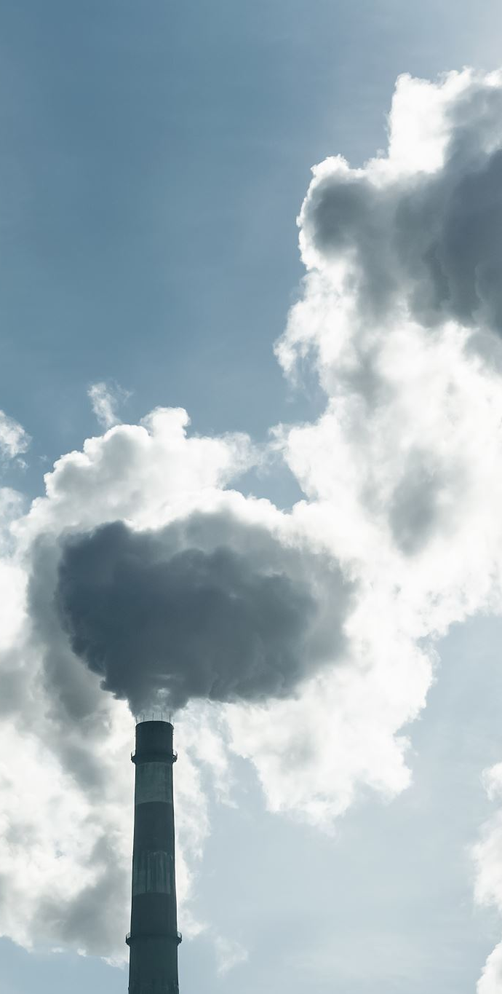
Introduction:
We’ll explore how science and technology can help us One of the most Pressing Challenges of Our Time , which is CO2 emissions.
Since many countries are facing problems caused by CO2 emissions , it's super important that we all work together to find new and clever ways to fix things.
Our main focus here revolves around the predictive power of Data Analytics in forecasting CO2 emissions specifically by vehicles

Slide 3

The Urgency of the Issue:
Before we dig into the analysis on CO2 Emission , let's take a moment to reflect on the urgency of the issue.
Climate change is no longer a distant threat , it's a reality we face today.
Rising global temperatures, extreme weather events, and the loss of biodiversity all underscore the critical need to limit CO2 emissions.
Our ability to predict and manage these emissions plays an important role in shaping an Eco-friendly future.

Slide 4

Let's Begin :

Slide 5

Importing the required libraries :

Slide 6
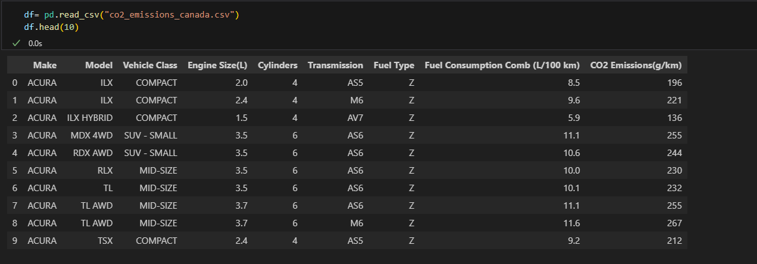
Importing the dataset :

Slide 7
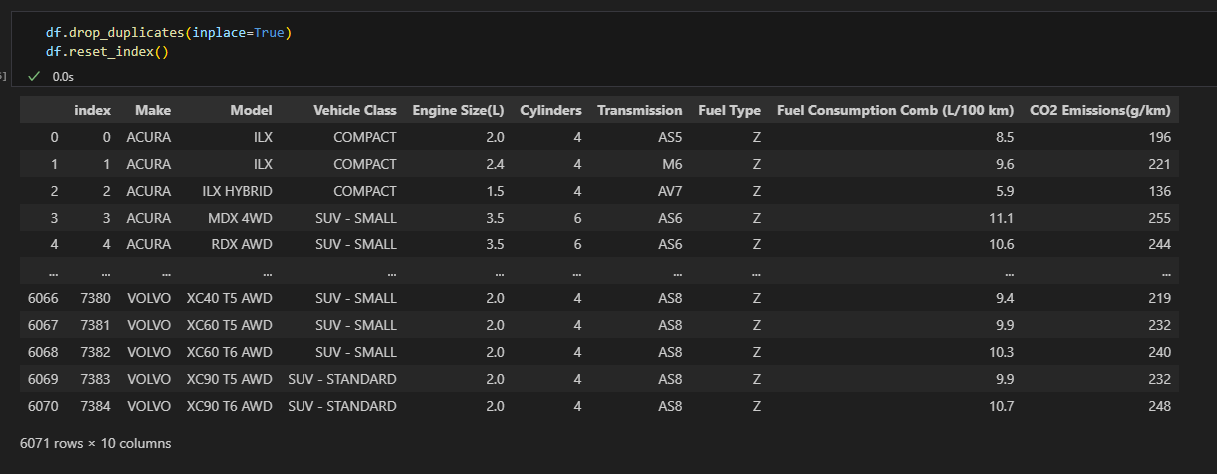
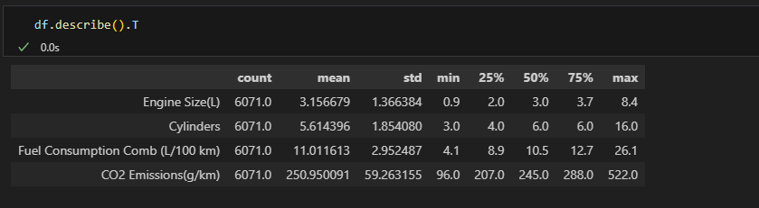
Removing Duplicates
Summarizing The Data

Slide 8


Slide 9
NOW
Why don’t we leave coding behind and focus on understanding the data

Slide 10
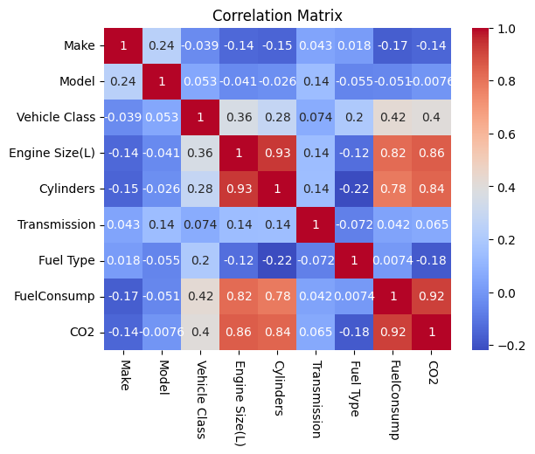
Checking correlation:

Slide 11
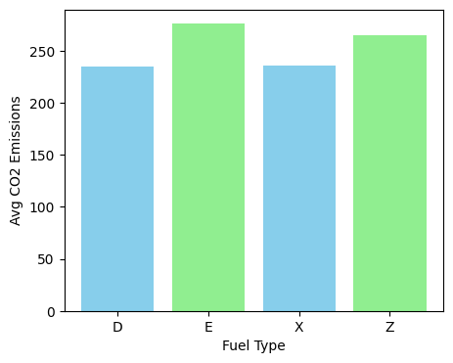
Fuel Type :
Does Fuel Type affect CO2 Emission?

Slide 12
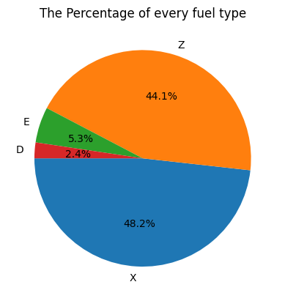
Fuel Type :
Which Fuel Type is used the most?

Slide 13
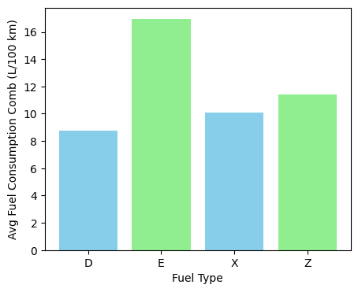
Fuel Consumption :
Does Fuel type affect Fuel Consumption?

Slide 14
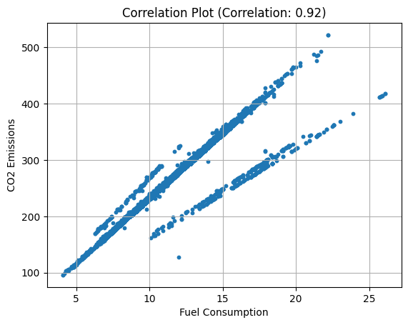
Fuel Consumption :
The relation between fuel consumption and CO2 Emission

Slide 15
Conclusion On Fuel :

Slide 16
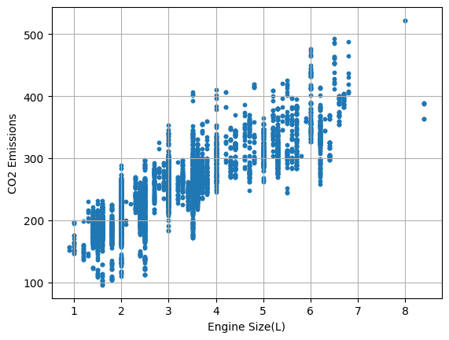
Engine Size :
The relation between Engine Size and CO2 Emission

Slide 17
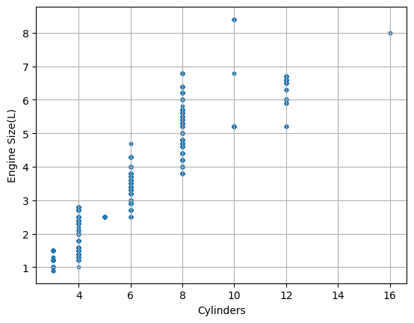
Engine Size :
The relation between Engine Size and Cylinders

Slide 18
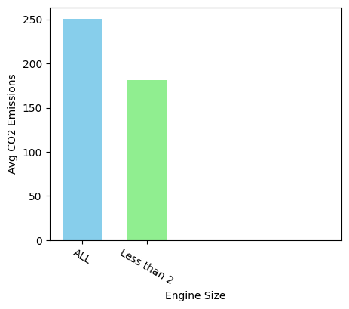
Engine Size :
What if we use an Engine with than size less than 2

Slide 19
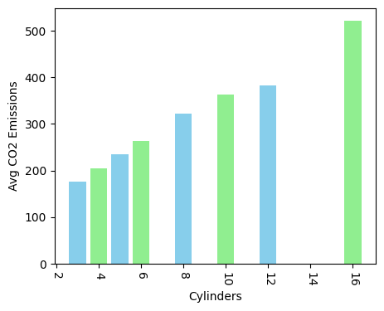
Cylinders :
Does Cylinders’ number affect CO2 Emission?

Slide 20
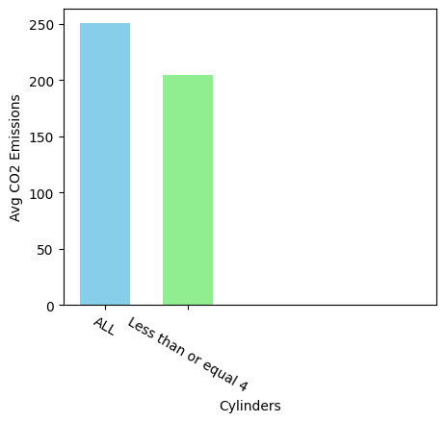
Cylinders :
What if we use Cylinders less than or equal 4

Slide 21
Conclusion on Engine Size and Cylinders :

Slide 22
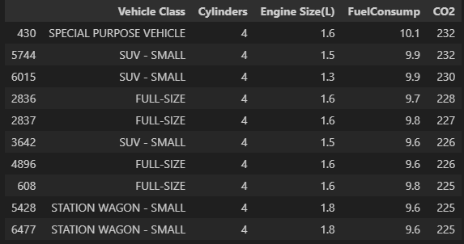
Conclusion on Engine Size and Cylinders :

Slide 23
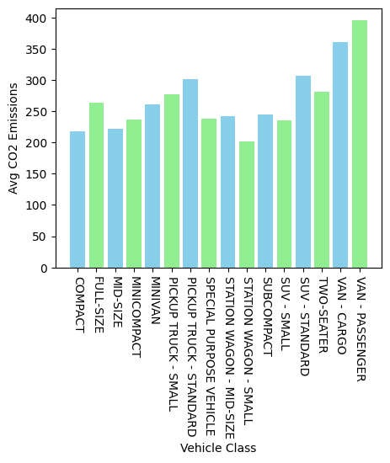
Vehicle Class :
Does vehicle class affect CO2 Emission?

Slide 24
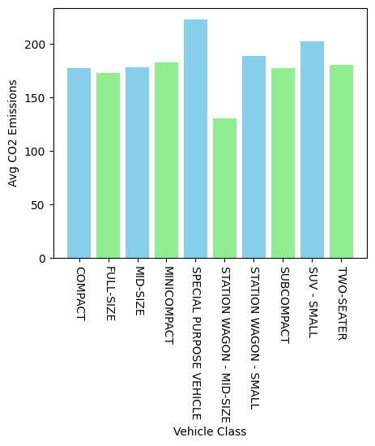
Vehicle Class :
What if we combine our conclusion on Engine with Vehicle Class

Slide 25
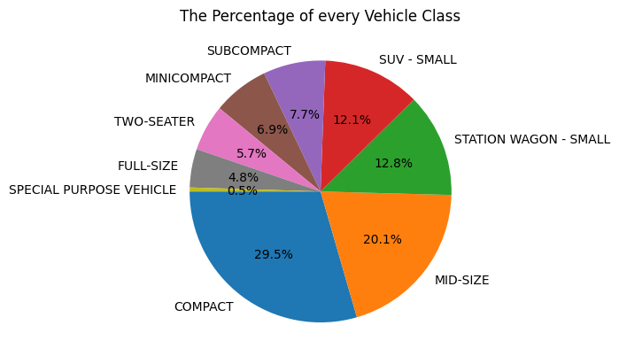
Vehicle Class :
Which Vehicle Class is used the most?

Slide 26
Conclusion on Vehicle Class:

Slide 27
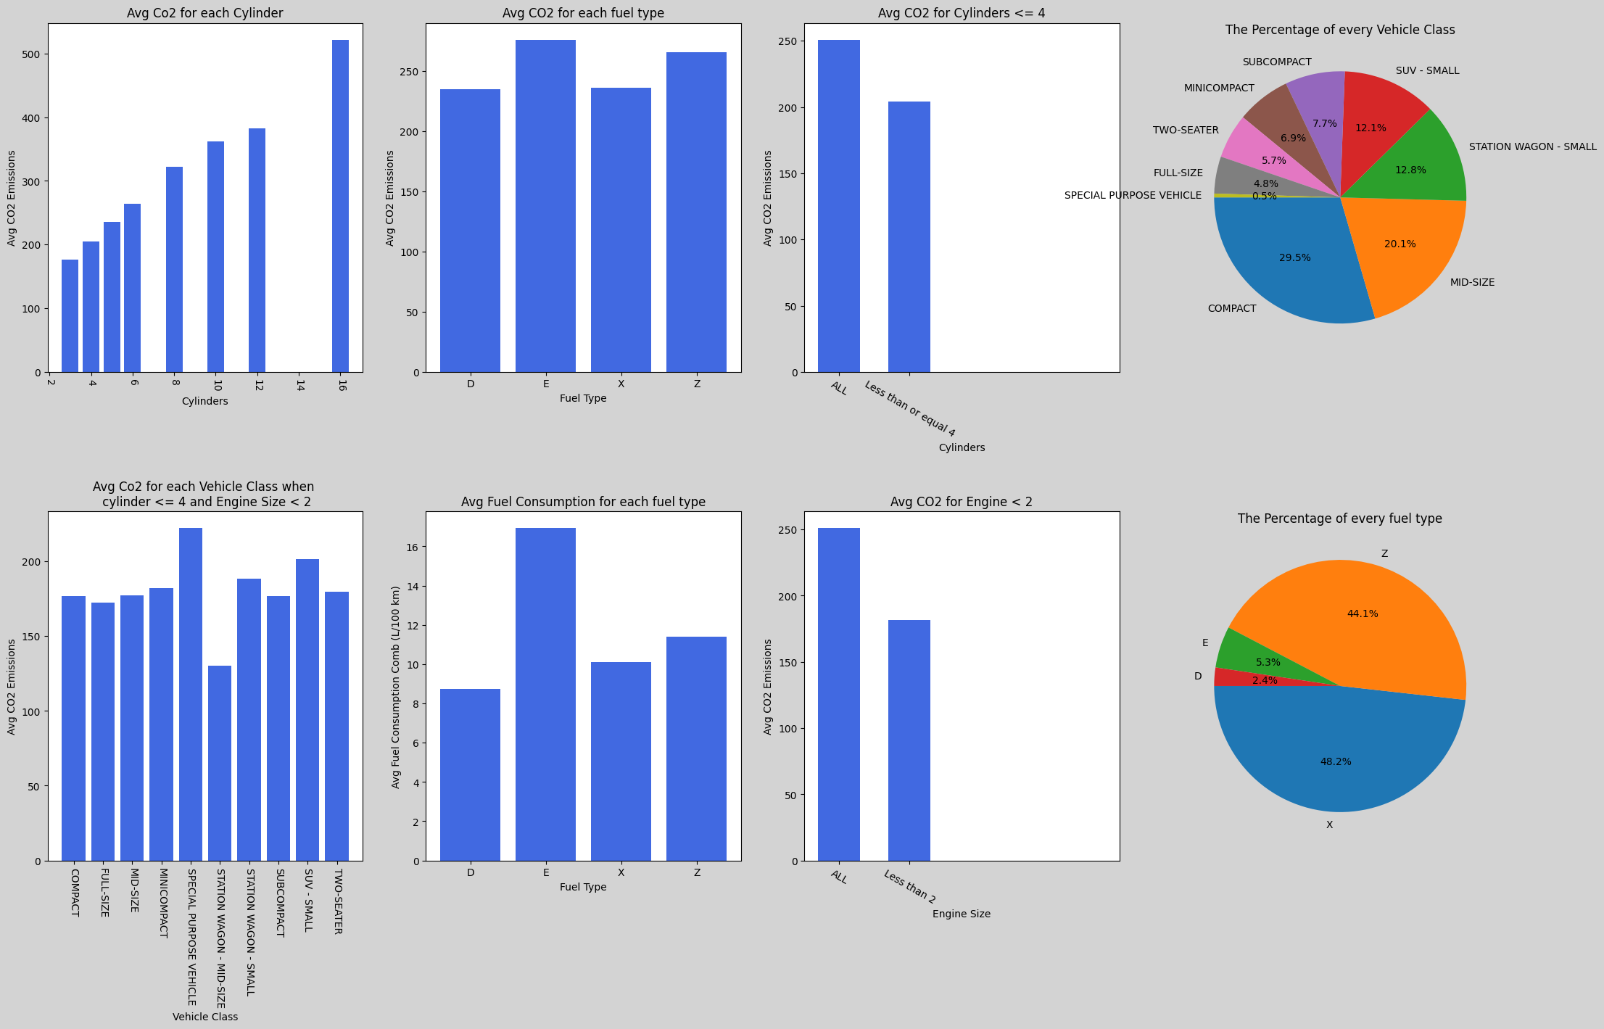
Conclusion :

Slide 28
THANK YOU.

